Slide 1
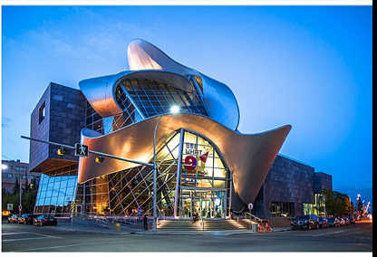
Capstone Project for Data Science course
The Final Assignment

Slide 2
Introduction and Business problem
This project deals with analysing the neighborhoods of Edmonton, the capital city of Alberta, Canada.
The objective of this project was to analyse the neighbourhoods in Edmonton and divide them into different clusters based on the popular venues at each neighbourhood, by using data science methodology and machine learning techniques like clustering.
The target audience of this project is small business owners who want to set up their businesses like restaurants, coffee shops, beauty and health stores, etc.

Slide 3
Data requirements
A dataset with Borough name, Neighborhoods, Post Code and GPS coordinates was taken from Wikipedia website
The Foursquare API was used to access the venues in the neighborhoods
Then neighborhoods were clustered based on their venues using Data Science Techniques, namely k-means algorithm
The optimal number of clusters was obtained using silhouette coefficient

Slide 4
Data requirements continue
Folium library was used to visualize the clusters on the map of Edmonton
These clusters were analysed to help small businesses select a suitable location for their need like restaurants, hotels, shopping malls
The pre-processing and data cleaning involved scraping data of Alberta region with all neighborhoods, then extracting directly neighborhoods of Edmonton and scraping venue items

Slide 5
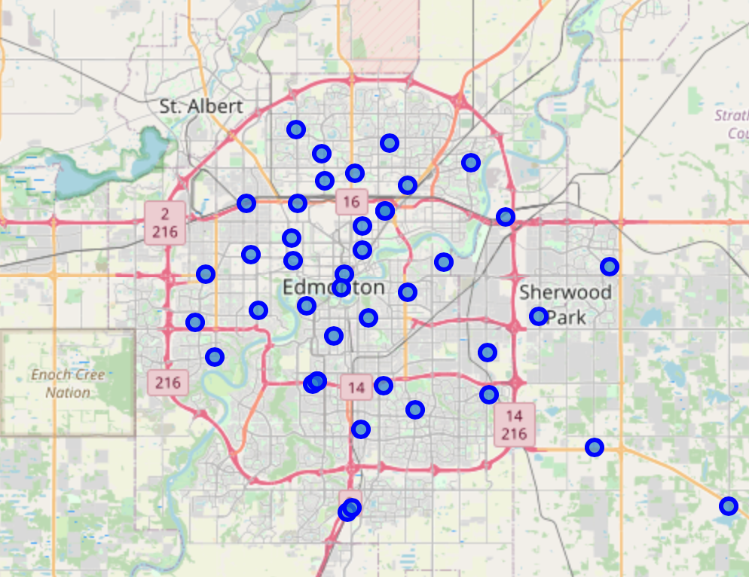
Methodology
In total:
38 neighborhoods were obtained
309 venues and 123 unique categories have been identified
Due to multiple neighborhoods with less than 5 venues were returned, I considered to use only the neighborhoods with more then 5 venues for a better analysis.
Using one hot encoding I found the 10 most common venue categories in each neighborhood.
Then KNN clustering technique have been used. To find the optimal number of clusters silhouette coefficient was counted.
The clusters can be analysed to suggest stakeholders suitable locations based on the category.
Edmonton map with neighborhoods

Slide 6
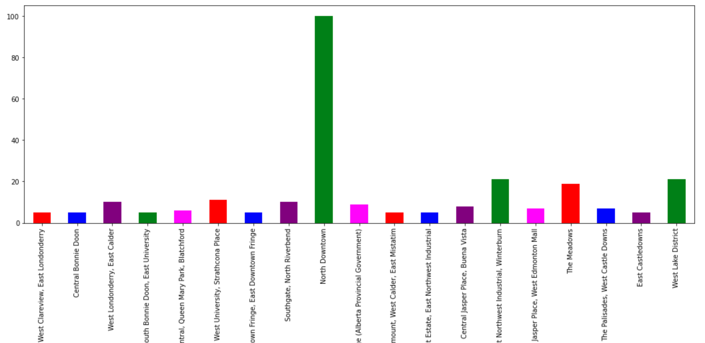
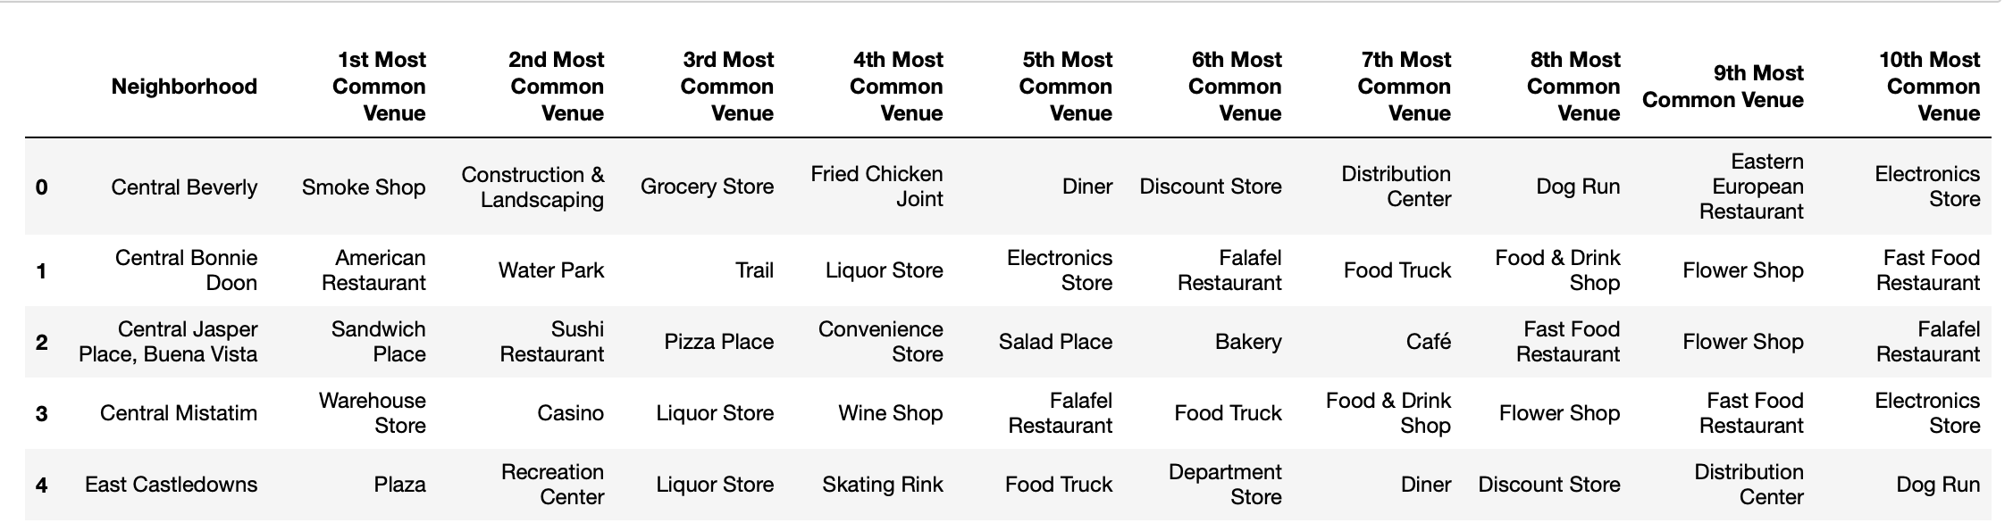
Analysis
Neighborhoods with more than 5 venues
As clustering technique, K-Nearest Neighbor (KNN) was applied
To find the best value for K, the silhouette coefficient was counted

Slide 7
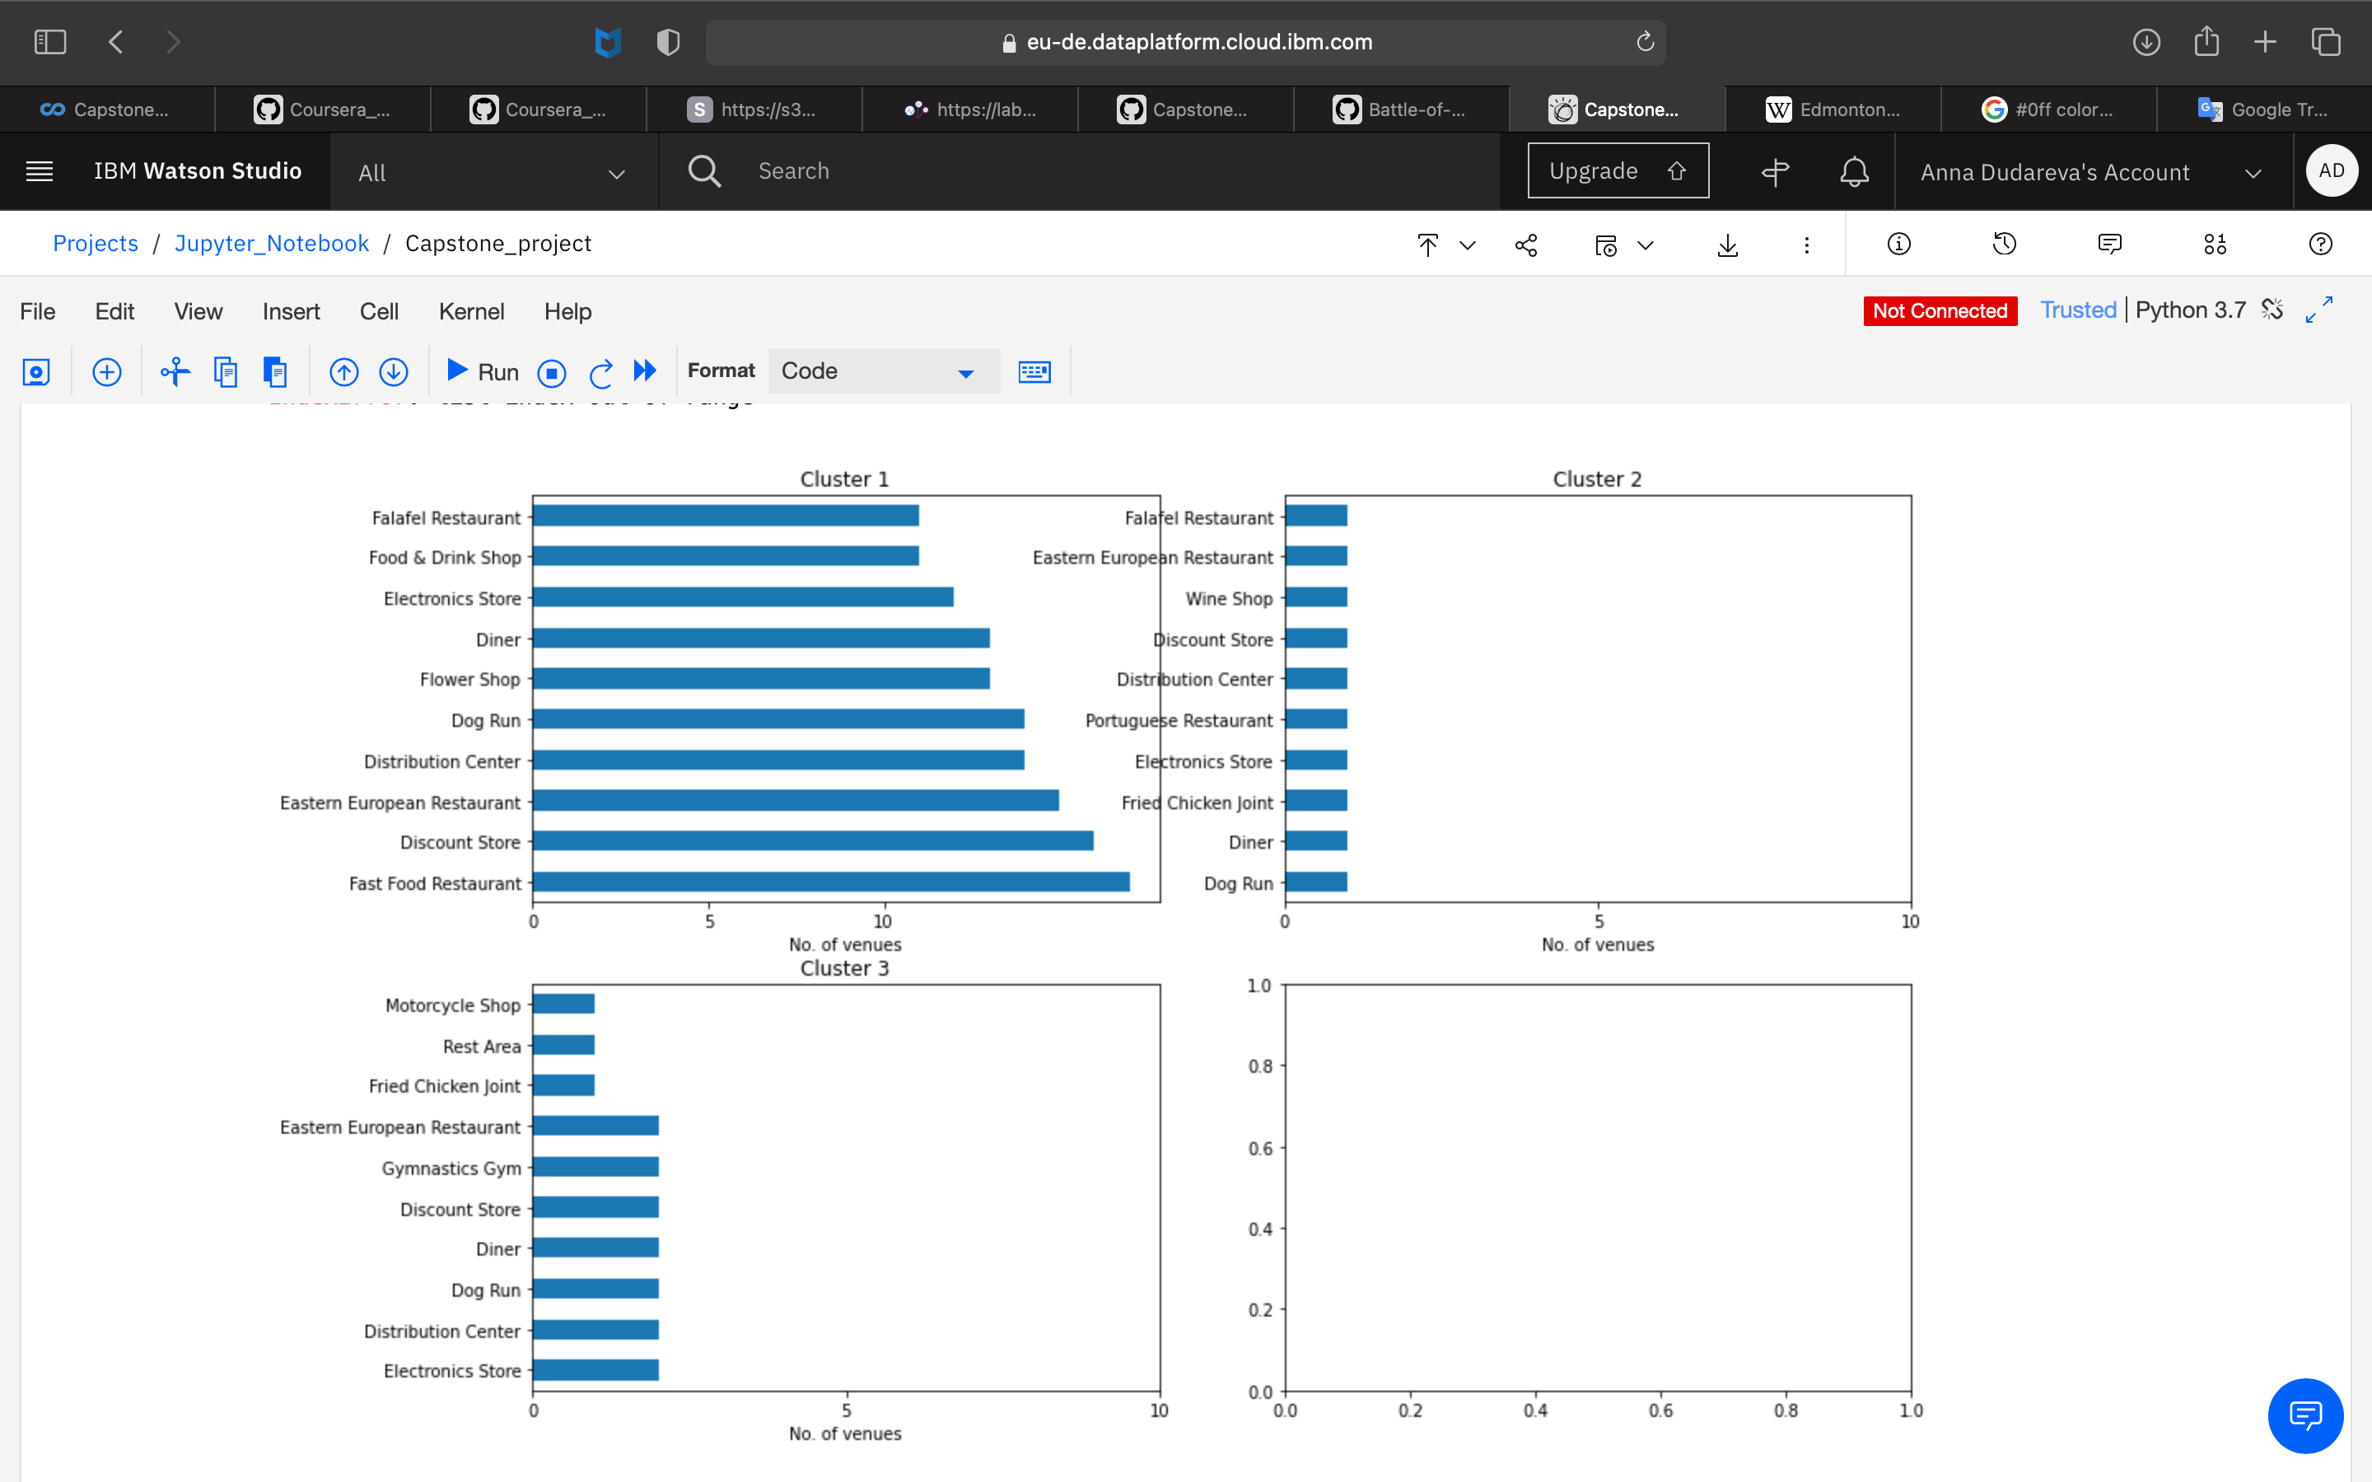
Results and Discussion
The optimal number of clusters was 3
Top 10 venues in each cluster were analyzed
This plot can be used to suggest valuable information to stakeholders

Slide 8
Results and Discussion continue Let’s discuss few examples:
The cluster 1 is situated within the central part of the city, and is saturated with fast food restaurants and some other type restaurants, hence opening one here is not the best choice. I could suggest that this cluster don't need more restaurants, but hotel/hostel, health & beauty shop, or bakery could be a good idea for business.
On the cotrary, cluster 3 is situated outside the central part of the city and has one fast food restaurant. Suggestion could be a coffee shop or one more, but another type fast food restaurant. If a deeper analysis could be done, due to location a major project could be suggested, as large shopping mall, indoor climbing park or amusement park for children etc.
Cluster 2 is the smallest one and is located in central part of the city. The most popular venues there are food and wine, so may be cluster 2 is a good place for a bar, pub or disco.

Slide 9
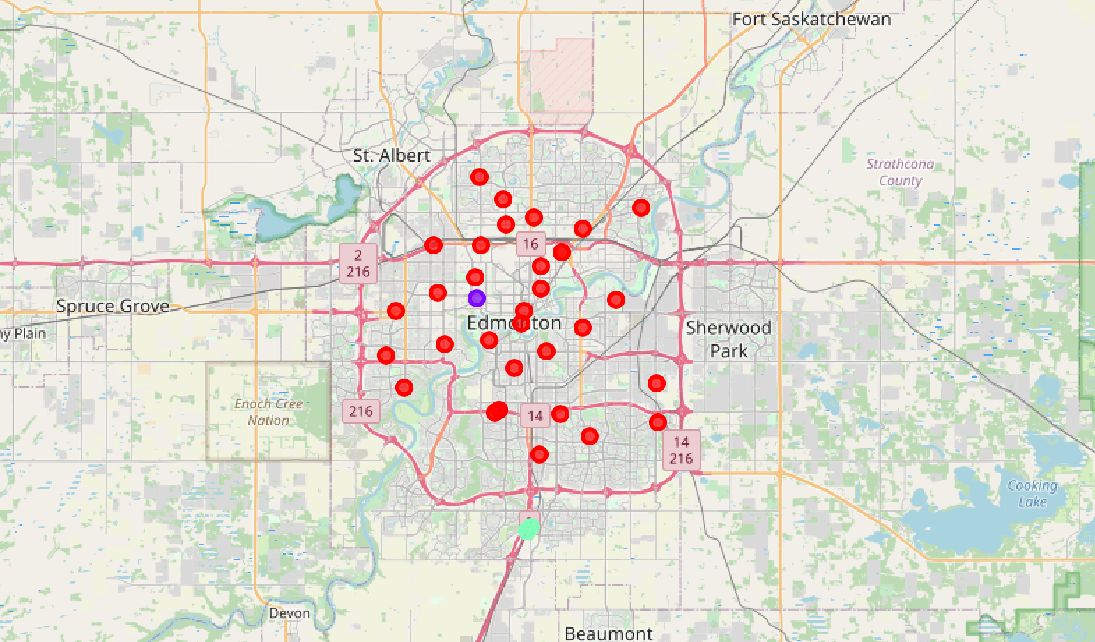
Map of Edmonton with three clusters which can be used to suggest the best location of a new business

Slide 10
Future directions
Better data sources to create a better decision model using KNN clustering
Due to limited API calls, paid account could be used to bypass limitations
For better analysis other factors could be included such as population in each neighborhood and income of residences, the concentration of commercial buildings that could influence the location decision

Slide 11
Conclusion
I have used different python packages to extract and scrap data from Wikipedia and to visualise it, also Foursquare API was used to explore the venues in neighborhoods
Final section of the project was to group venues in clusters and define the characteristics for that particular cluster. I have found three clusters:
to of which are situated in the central part of the Edmonton,
the third cluster is located outside
A few examples have been discussed
A map showing the clusters have been provided
So, all this information can be used by stakeholders to decide the location for the particular type of business

Slide 12
Thank you!

